Slide 1



CSA0504 - DATABASE MANAGEMENT SYSTEM
CO1 - AT3 - TECHNICAL PRESENTATION
Presented By: Under The Supervision of :
V.C.Bhavan Bairav (192511369) Dr.R.Kesavan

Slide 2
QUESTIONS
Q. No. | Question
1 | Create and present an ER diagram for an Online Library System, explaining each component clearly.
2 | Prepare a presentation on the EER model, demonstrating generalization and specialization with a University case study.
3 | Present the concept of data independence (logical and physical) and its significance in DBMS architecture.
4 | Deliver a technical presentation on the software components of a DBMS, explaining query processor, storage manager, and transaction manager.
5 | Prepare a presentation comparing strong and weak entities in ER modeling with real-world examples.

Slide 3
INTRODUCTION
1) What is an ER Diagram?
ER (Entity-Relationship) Diagram is a graphical representation of a database.
It shows Entities, Attributes, and Relationships.
It is used to design the database before implementation.
Objective:
To design a database that efficiently manages:
Library members
Books
Authors
Publishers
Book borrowing information

Slide 4
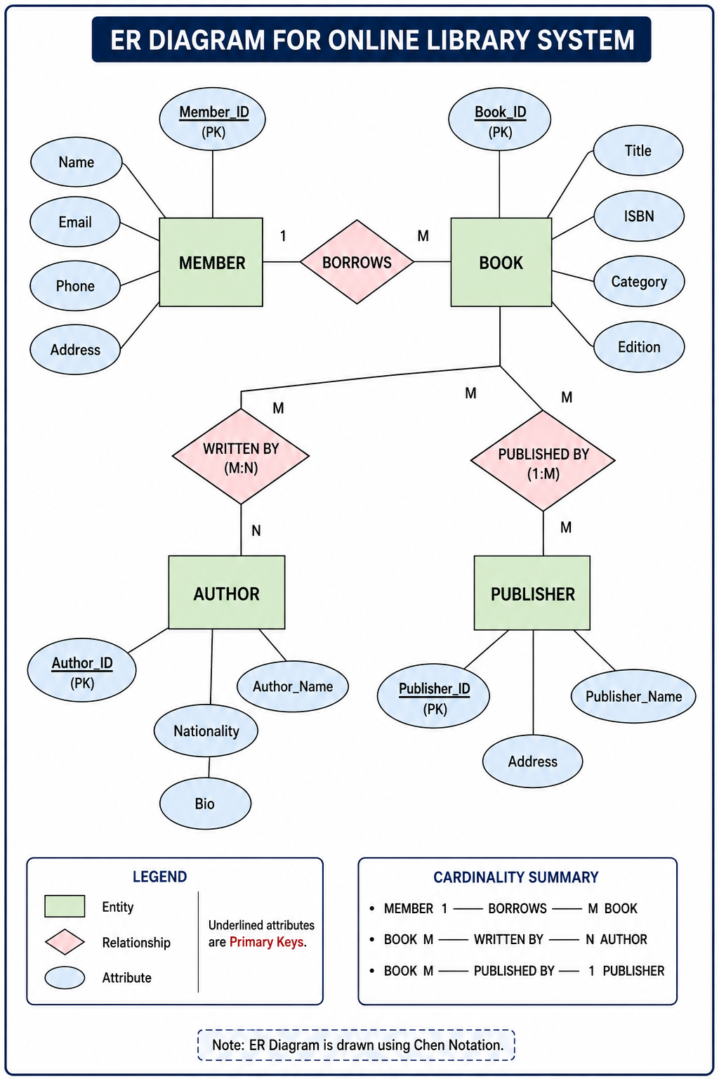
ER DIAGRAM

Slide 5
COMPONENTS OF THE ER DIAGRAM
2. Attributes:
Member
Member_ID (Primary Key)
Name
Email
Phone
Book
Book_ID (Primary Key)
Title
ISBN
Category
Author
Author_ID
Author_Name
Publisher
Publisher_ID
Publisher_Name
1. Entities:
Member – Stores member details.
Book – Stores book information.
Author – Stores author details.
Publisher – Stores publisher details.
3. Relationships:
Borrows
Writes
Publishes

Slide 6
ADVANTAGES & CONCLUSION
Advantages:
Reduces data redundancy.
Organizes library records efficiently.
Makes searching and managing books easier.
Improves data consistency.
Simplifies future database development.
Conclusion:
ER diagrams provide a clear blueprint for database design.
They identify entities, attributes, and relationships.
The Online Library ER model can be easily converted into relational tables for implementation in a DBMS.

Slide 7
INTRODUCTION
2) Enhanced Entity-Relationship (EER) Model
What is an EER Model?
The Enhanced Entity-Relationship (EER) Model is an extension of the ER Model.
It represents more complex real-world scenarios.
It introduces Generalization, Specialization, and Inheritance.
Features:
Supports inheritance of attributes.
Reduces data redundancy.
Models complex organizational structures.
Objective:
To demonstrate Generalization and Specialization using a University Management System.

Slide 8
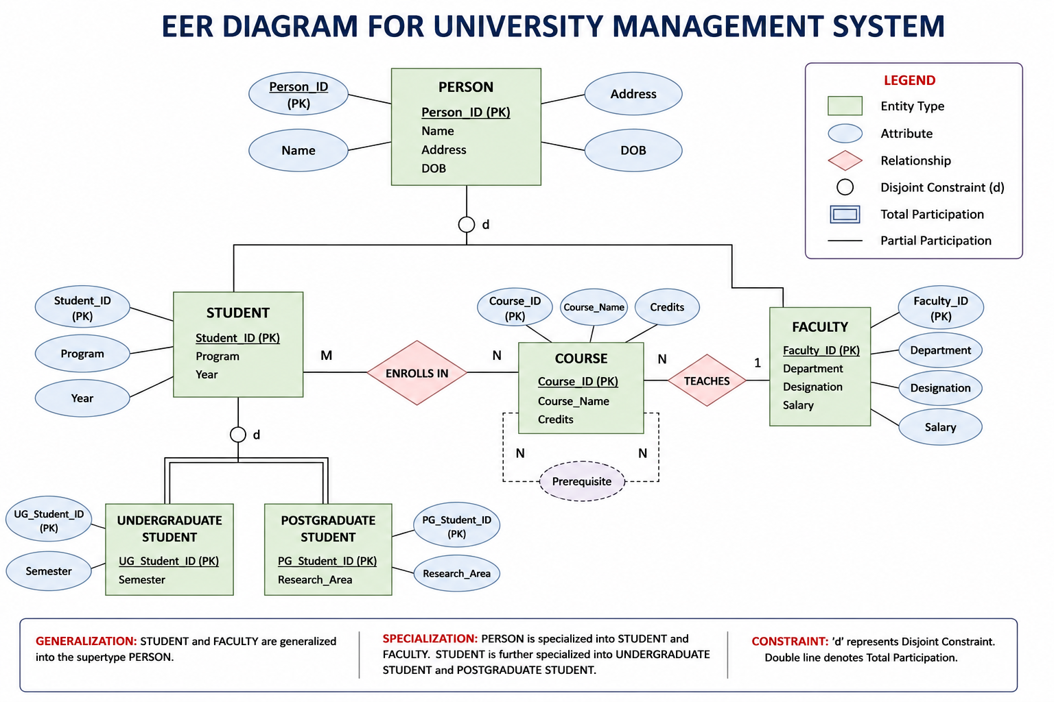
EER Diagram

Slide 9
GENERALIZATION AND SPECIALIZATION
Generalization:
Bottom-up approach.(Many One)
Combines similar lower-level entities into one higher-level entity.
Example:
Student
Faculty
Administrator
⬇
Person
Specialization:
Top-down approach.(One Many)
Divides one higher-level entity into more specific entities.
Example:
Person
⬇
Student
Faculty
Student
⬇
Undergraduate Student
Postgraduate Student

Slide 10
ADVANTAGES & CONCLUSION
Advantages of EER Model:
Models complex real-world systems.
Supports inheritance of attributes.
Reduces redundancy.
Improves database organization.
Makes database maintenance easier.
Conclusion:
EER extends the traditional ER model.
Generalization and Specialization improve database flexibility.
The University case study demonstrates efficient modeling of people and their roles.

Slide 11
INTRODUCTION
3) Data Independence in DBMS
What is Data Independence?
Data Independence is the ability to modify the database schema without affecting application programs.
It allows changes at one level of the database without impacting higher levels.
It is achieved through the three-level DBMS architecture (ANSI/SPARC).
Types of Data Independence:
Physical Data Independence
Logical Data Independence

Slide 12
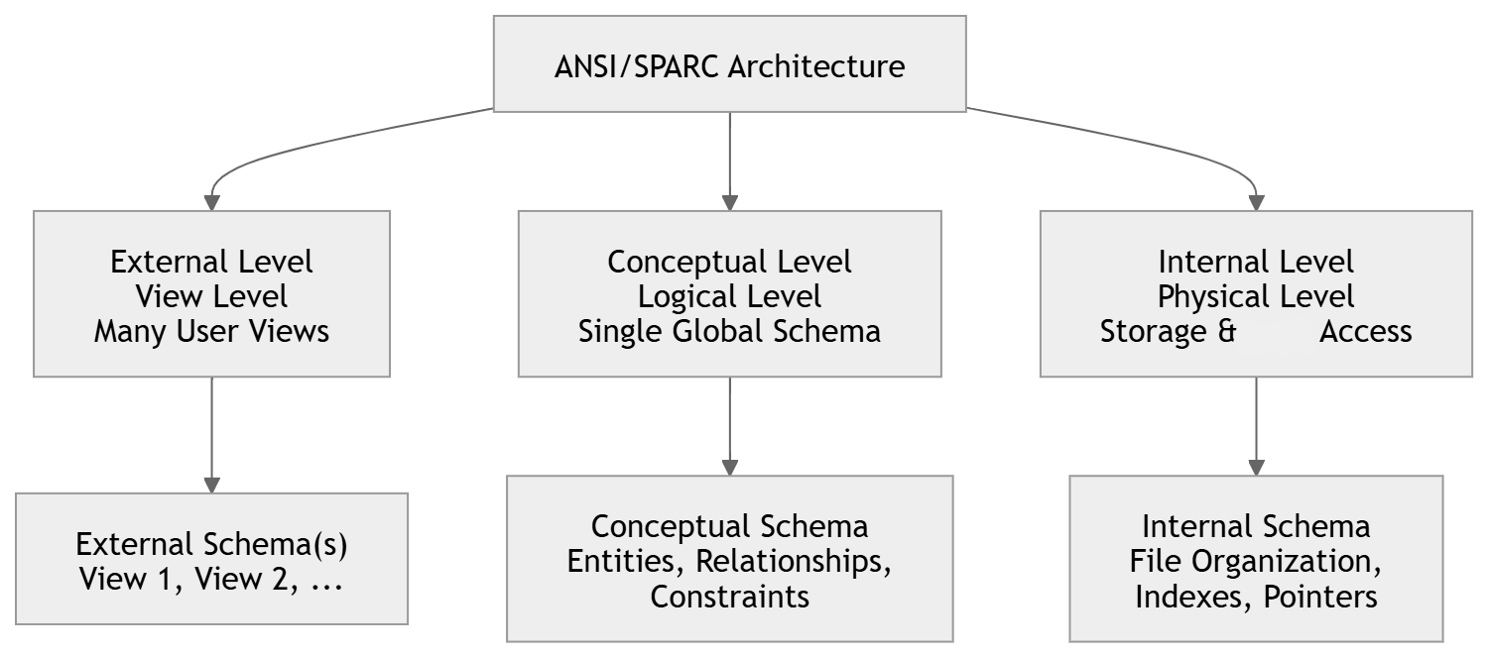
DBMS THREE-LEVEL ARCHITECTURE

Slide 13
TYPES OF DATA INDEPENDENCE
1. Physical Data Independence:
Changes in physical storage do not affect the conceptual schema (Logical level).
Examples:
Changing file organization
Creating indexes
Changing storage devices
Easier to achieve.
2. Logical Data Independence:
Changes in the schema (Logical level) do not affect user views (External Level).
Examples:
Adding new attributes
Adding new entities
Modifying relationships
More difficult to achieve.

Slide 14
SIGNIFICANCE & CONCLUSION
Significance of Data Independence:
Reduces application maintenance.
Provides flexibility in database design.
Improves data consistency.
Enhances scalability.
Simplifies database administration.
Conclusion:
Data Independence is a key feature of DBMS architecture.
Physical Data Independence deals with storage changes.
Logical Data Independence deals with schema changes.
It makes databases reliable, maintainable, and scalable.

Slide 15
INTRODUCTION
4) Software Components of a DBMS
What is a DBMS?
A Database Management System (DBMS) is software used to create, store, retrieve, and manage data.
It acts as an interface between users and the database.
Main Software Components:
Query Processor
Storage Manager
Transaction Manager

Slide 16
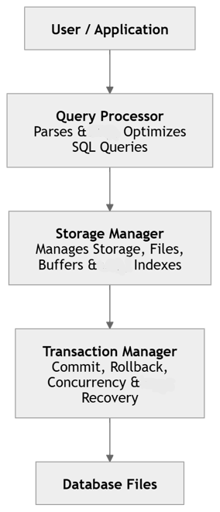
DBMS SOFTWARE ARCHITECTURE
Flow:
User submits SQL query.
Query Processor interprets and optimizes it.
Storage Manager accesses data.
Transaction Manager ensures consistency and recovery.

Slide 17
COMPONENTS
1. Query Processor
Interprets SQL queries.
Checks syntax and semantics.
Optimizes query execution.
Generates an execution plan.
2. Storage Manager
Manages physical storage.
Retrieves and stores data.
Handles indexes and buffers.
Organizes files efficiently.
3. Transaction Manager
Ensures ACID properties.
Controls concurrent transactions.
Performs commit and rollback.
Supports crash recovery.

Slide 18
ADVANTAGES & CONCLUSION
Advantages:
Fast query execution.
Efficient data storage.
Safe transaction processing.
Supports multiple users.
Ensures data integrity and reliability.
Conclusion:
The Query Processor manages SQL queries.
The Storage Manager manages data storage.
The Transaction Manager guarantees reliable transactions.
Together, these components make a DBMS efficient, secure, and reliable.

Slide 19
INTRODUCTION
5) Strong and Weak Entities in ER Modeling
What is an Entity?
An entity is a real-world object that can be uniquely identified.
Entities are represented by rectangles in an ER diagram.
Types of Entities:
Strong Entity
Weak Entity
Objective:
To compare strong and weak entities using real-world examples.

Slide 20
STRONG ENTITY VS WEAK ENTITY
STRONG ENTITY | WEAK ENTITY
Has its own Primary Key | Does not have a complete Primary Key
Exists independently | Depends on a Strong Entity
Represented by a single rectangle | Represented by a double rectangle
Identified uniquely by its own attributes | Identified using a Partial Key and the owner's Primary Key
Example: Student, Employee | Example: Dependent, Order Item

Slide 21
REAL-WORLD EXAMPLE
Bank Account and Transaction
Strong Entity:
Bank Account
Account_Number (Primary Key)
Account_Holder
Balance
Weak Entity:
Transaction
Transaction_ID (Partial Key)
Date
Amount
Type (Deposit/Withdrawal)
Relationship:
A Bank Account has many Transactions.
A Transaction cannot exist without a Bank Account.

Slide 22
ADVANTAGES & CONCLUSION
Advantages:
Represents real-world relationships accurately.
Reduces data redundancy.
Improves database organization.
Ensures data integrity.
Supports efficient database design.
Conclusion:
Strong Entities have independent existence.
Weak Entities depend on Strong Entities.
Weak Entities require an Identifying Relationship and a Partial Key.
Both are essential for designing accurate ER models.

Slide 23
THANK YOU

